Slide 1

Introducing Fiduciary Operating System (FOS)
At the intersection of legacy and logic lies the first Operating System designed specifically for Registered Professional Fiduciaries. Move beyond Excel, protect privilege, and secure the generational transfer of wealth.

Slide 2
The $3 Trillion Problem
The professional fiduciary market is currently trapped in a "technological pre-history," relying on a fragile bricolage of generalist tools—principally Microsoft Excel, email clients, and disparate cloud storage—to manage high-net worth, multi-generational wealth.
$3T
47%
Assets Under Management
Time Lost Searching
For critical documents
This fragmented approach introduces significant personally liable for the fiduciary through legal privilege breaches, miscalculations in tax withholdings, tax nexus triggers and trustee continuity risk.
Held in disparate systems
Introducing FOS, the breakthrough system that neutralizes these liabilities by architecting a privileged collaboration environment specifically designed to shield strategic estate interests from legal discovery. By securing institutional memory through its unique Digital Successor mechanism, FOS transforms operational vulnerability into a permanent, protected legacy for both the fiduciary and the estate.
The fragmentation isn't just inefficient for the trust, it's potentially devastating for the trustee.

Slide 3




The Foundation Failures
"The Continuity Factor" Anxiety
The "Privilege Trap"
"Excel + Email" Chaos
Sharing draft valuations or legal memos in common folders like Dropbox risks waiving attorney-client privilege during discovery. One wrong click destroys protection.
Asset values live in Excel, context in Outlook, files in Google Drive. No single source of truth. Critical decisions made on incomplete information.
If the fiduciary becomes incapacitated or dies, the estate's data is lost or locked in their laptop — leaving successors scrambling and beneficiaries liable. No continuity plan. No fail-safe.

Slide 4




FOS Solution: Foundational
Digital Successor Protocol
The "Meet-Me Room"
Unified Command Center
Automated dead man's switch transfers encrypted access to a named successor after confirmed inactivity. Liability eliminated.
Segregated Iron Vault for privileged drafts, invisible to beneficiaries. Privilege toggle maintains attorney-client protection with forensic precision.
Ledger, inbox, and file vault integrated into one view. Assets linked to supporting documents and emails. Single source of truth, always.

Slide 5



Hidden Tax & Search Crisis
Retrieval Friction
Tax Nexus Liability
Valuation Strategy Blindness
Fiduciaries waste hours searching for "that one email about Peruvian tax law" across five different client inboxes. Productivity hemorrhages while billable hours climb.
A California trustee administering a Nevada trust accidentally triggers CA state income tax by working from home. Geography becomes a legal minefield.
Missing the step-up basis window because nobody tracked the Estate Tax Exemption threshold. A $15M oversight costs beneficiaries millions.

Slide 6
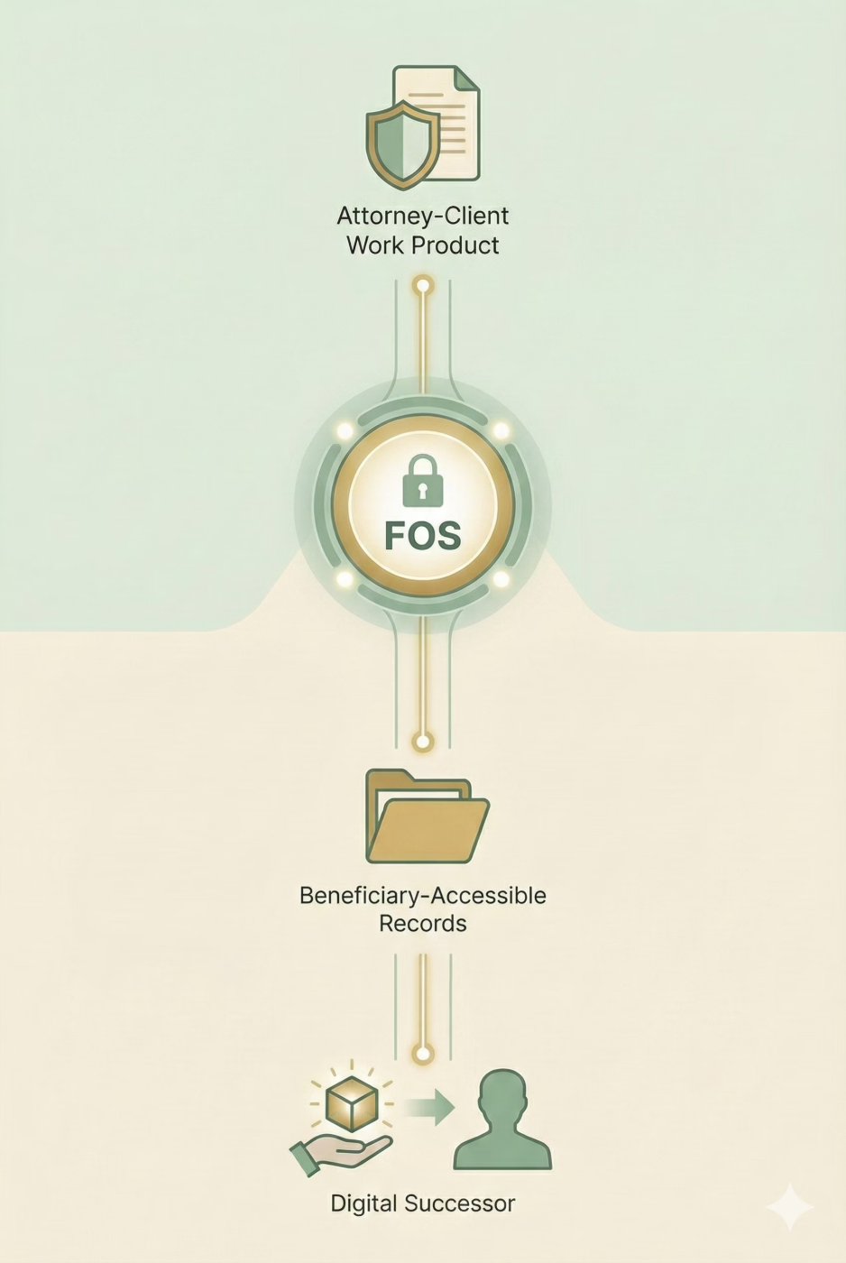



FOS Solution: Intelligent Automation & Compliance
Context-Aware Inbox
Jurisdiction Watchdog
AI-powered ingestion auto-tags emails to specific Trust and Subject (Tax, Legal, Beneficiary). Search solved.
Geo-fenced alerts warn when physical location conflicts with Trust situs. Tax nexus liability prevented before it happens.
"Tax Cliff" Intelligence
Dynamic alerts suggest maximizing or minimizing appraisal values based on current tax law and estate size. Never miss a threshold.

Slide 7




Operational Breakdowns
Beneficiary Impatience
"Why can't I have my money now?" Constant pestering for distributions erodes trust and wastes fiduciary time on explanations that should be self-evident.
Manual Marshaling Tedium
Typing bank statement balances into Excel manually is error-prone, tedious, and creates audit risk. Every entry is a potential mistake.
Court Accounting Nightmare
Separating "Principal" vs. "Income" for court reports is nearly impossible in QuickBooks or standard accounting tools. UPIA compliance becomes a quarterly crisis.

Slide 8



FOS Solution: Transparency & Precision
Reserve Calculator & Transparency Portal
Live Asset Ledger
Fiduciary Accounting Engine
Centralized tracking of all assets with status tags (Retitled, Sold, Distributed) and complete value history. Manual data entry eliminated. Accuracy guaranteed.
Native UPIA (Uniform Principal and Income Act) support built into the platform. Court-ready reports generated instantly. Compliance becomes automatic.
Data-backed logic justifies withholdings automatically. Beneficiaries access a controlled view-only portal to see status without pestering. Trust restored.

Slide 9
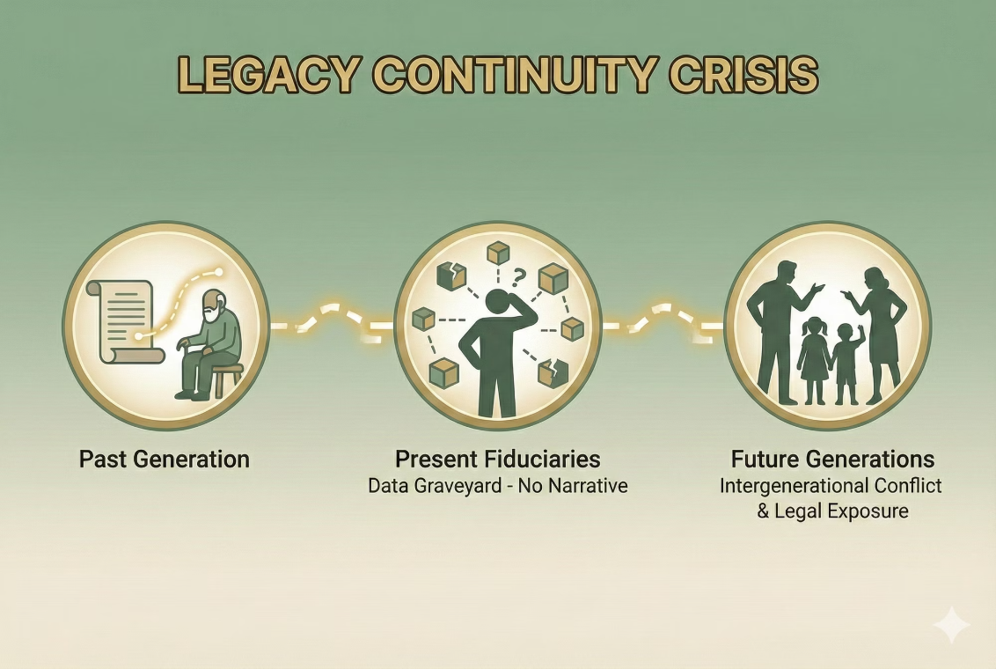
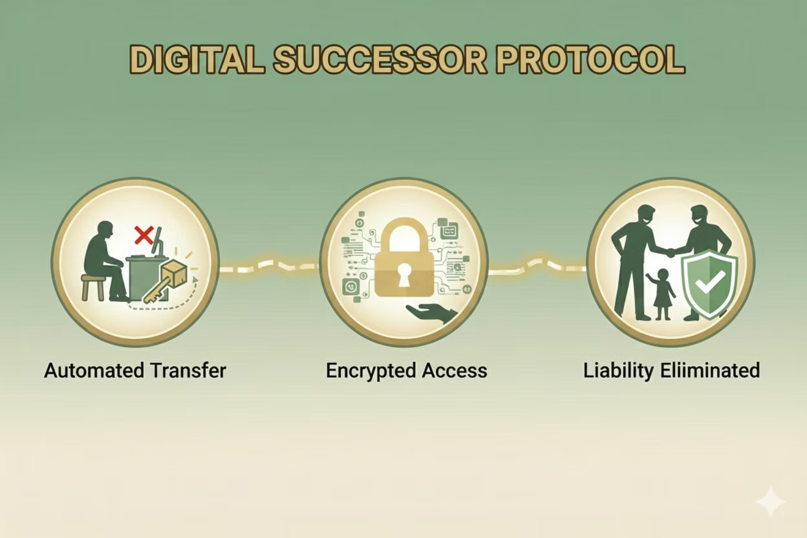
The Dynasty Trust Dilemma
Legacy Continuity Crisis
Dynasty trusts can last 300+ years, spanning multiple generations of trustees and beneficiaries. Without institutional memory, the "story" of the trust — the intent, context, and critical decisions — evaporates.
Future fiduciaries inherit a data graveyard with no narrative. Legal exposure compounds.
Beneficiary confusion becomes intergenerational conflict.
Introducing the FOS "Successor Trigger." Upon proof of death/incapacity of the primary Fiduciary, the account ownership seamlessly transfers to the named Successor Trustee, preserving all history, context, and privileged files, ensuring the institutional memory survives you.
Each successful login re-authenticates your agency and resets
the countdown clock.
All final documents are converted to PDF/A (Archival) format.
Structured data (ledger entries) are exportable in open standard formats (JSON/XML) to ensure no vendor lock-in over 100 years.

Slide 10








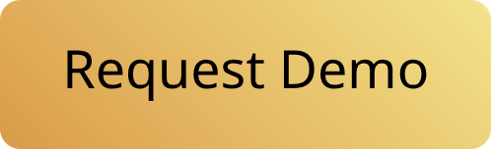

FOS: The Complete Solution
Permanent Vault
Single Platform
PDF/A archival standards and immutable audit logs preserve the complete trust story for future generations.
All risks and inefficiencies solved in one unified system — no duct-taping disparate tools together.
Liability Shield
Scalable Infrastructure
Every feature designed to reduce legal exposure and ensure compliance from day one.
Built for professional fiduciaries managing portfolios of high-net-worth trusts, not individuals.
The cost of complexity is measured in liability, lost time, and eroded trust. FOS eliminates all three.

